Slide 1
Pantheon: Preemptible Multi-DNN Inference on Mobile Edge GPUs
Lixiang Han, Zimu Zhou, Zhenjiang Li
City University of Hong Kong
ACM MobiSys 2024

Slide 2
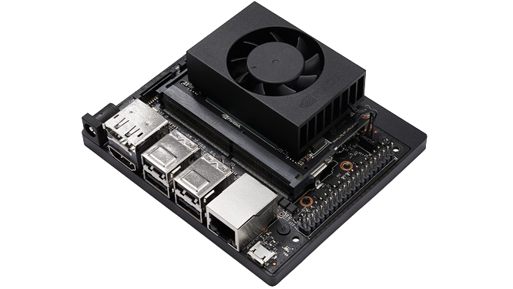




Multi-DNN Inference on Mobile Edge GPUs
Autonomous Vehicle
Smart Surveillance
Robotic
Multi-DNN
Tasks
…
Jetson Devices
Task 1:
Pedestrian detection
Task 2:
Lane segmentation
Task 3:
Traffic sign classification

Slide 3

Real-time Multi-DNN Inference
Preemption enabled
Task 2
Deadline
Task 2
Deadline
0
30
0
30
Task 3
Deadline
Deadline miss
Task 3
Deadline
Time
5
15
Time
Preemption is important for ensuring the timeliness of
multi-DNN inference!
5
15
Deadline
20 ms
30 ms
10 ms
Task 1:
Pedestrian detection
Task 2:
Lane segmentation
Task 3:
Traffic sign classification

Slide 4
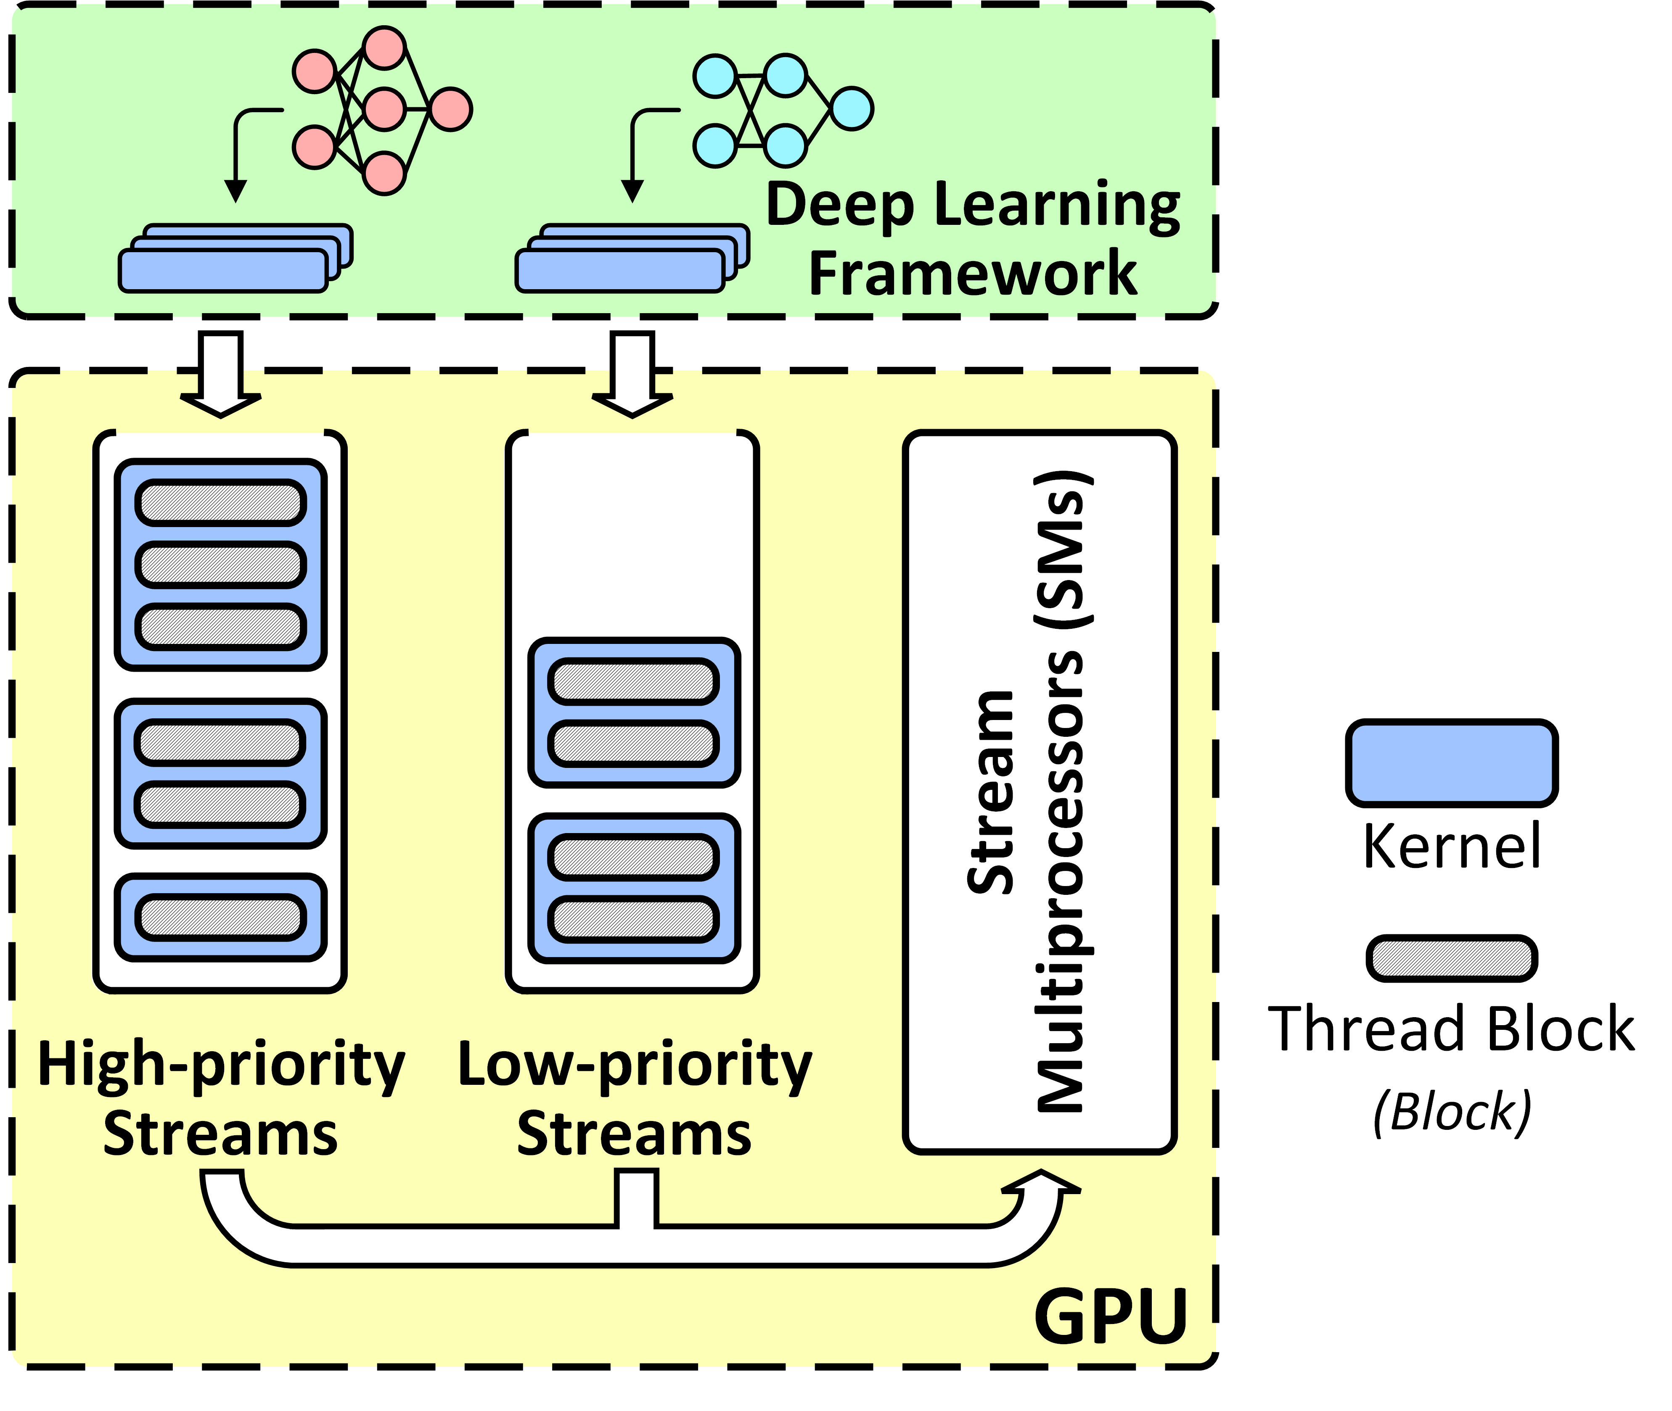
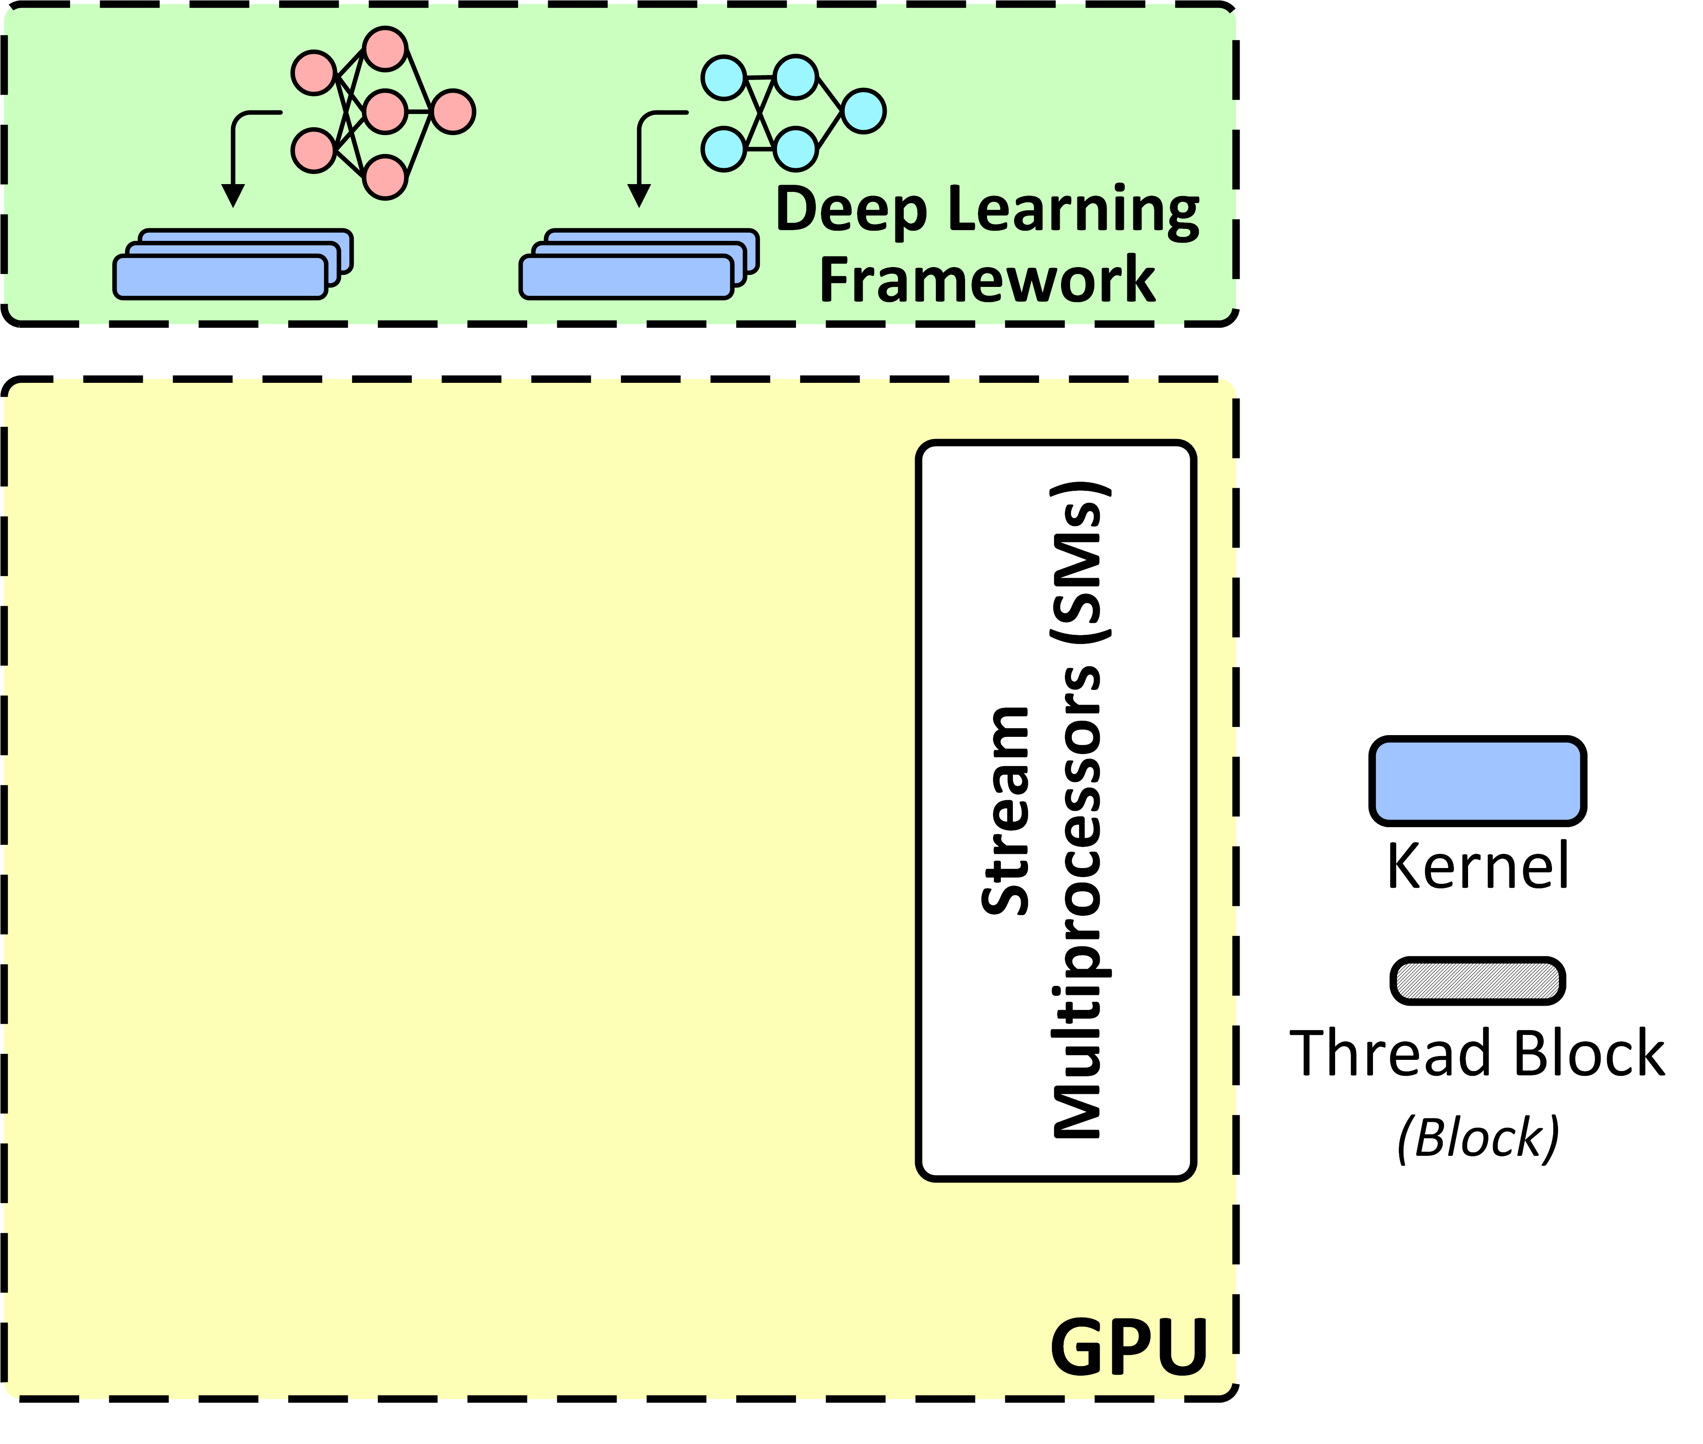

Preemption Support on Mobile Edge GPUs
Two-tier preemption only !
e.g. real-time w/ deadline
v.s.
What if there are multiple real-time DNN tasks?
best-effort w/o deadline^{[1]}
Mobile edge GPUs
Voice Assistant
[1] Han, M., et al. Microsecond-scale preemption for concurrent GPU-accelerated DNN inferences. USENIX OSDI 2022.

Slide 5

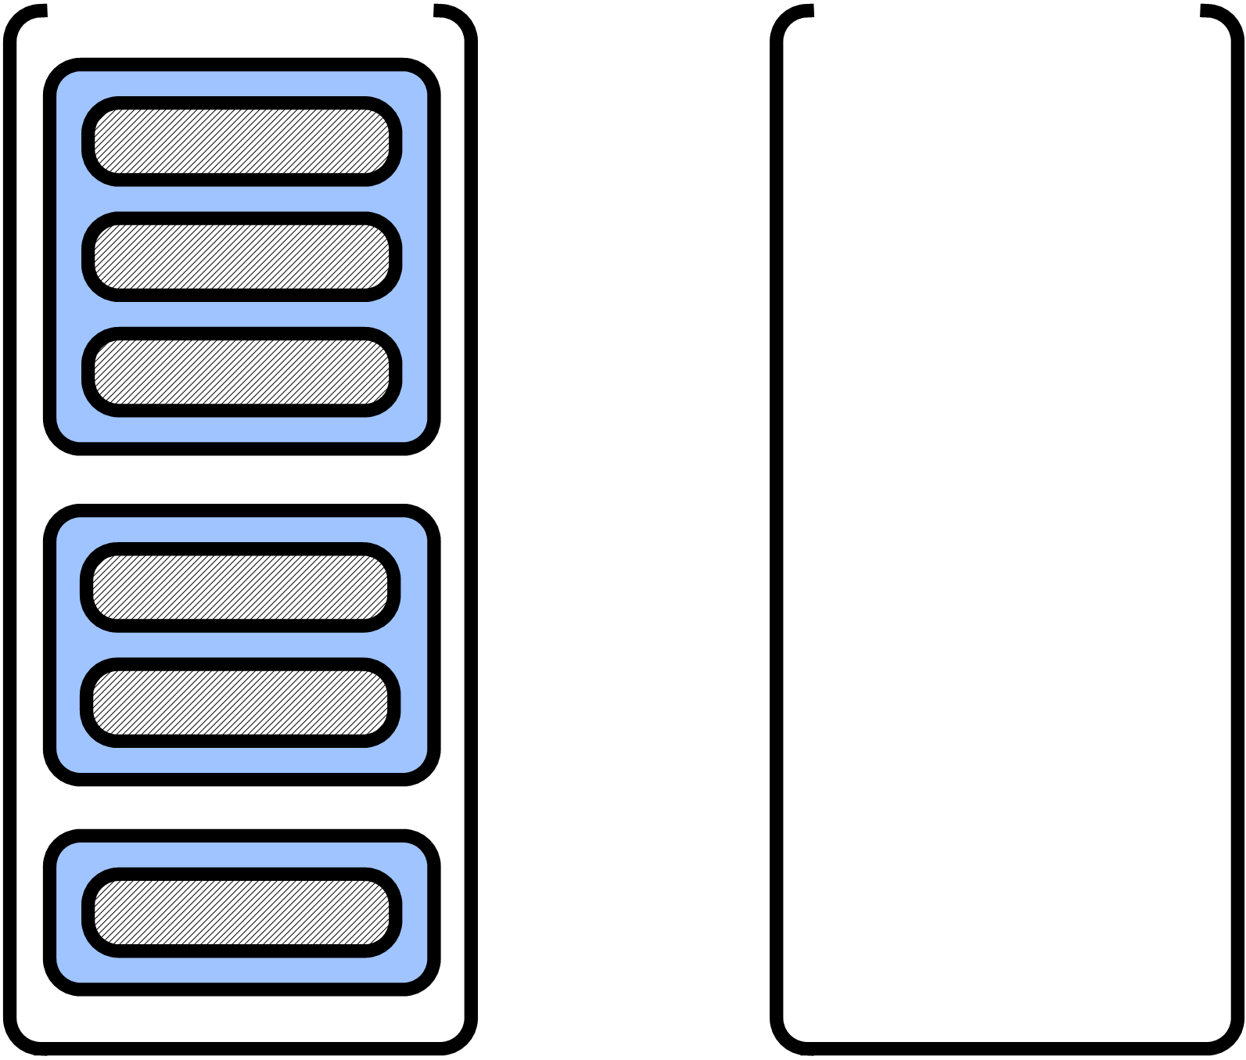

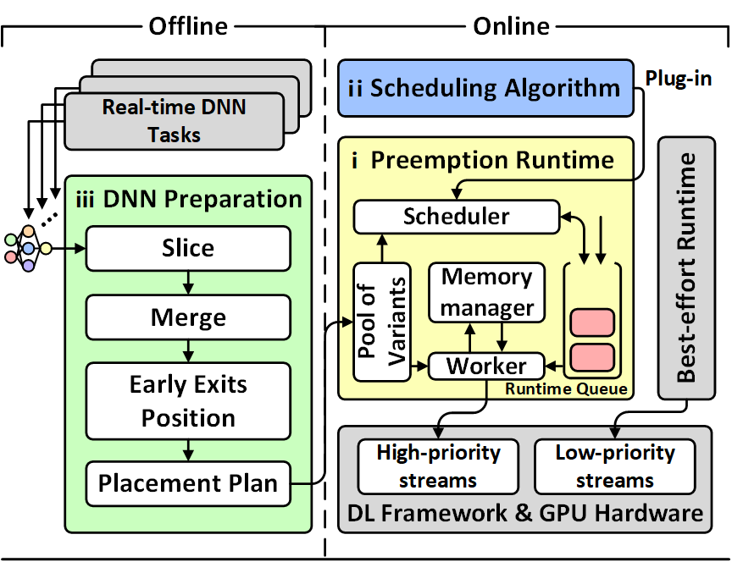
Challenge 1: Limited Preemption Support
More GPU stream priorities?
1) Stream-bonded priority
…
2) Close-sourced GPU driver
Lowest
Priority
Highest
Idea – Enable preemption logic between real-time tasks before entering high-priority GPU streams

Slide 6
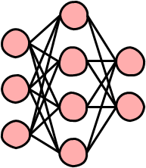
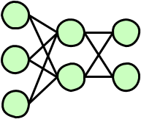

Challenge 2: DNN-oriented Context Switch
Preempted DNN task may not complete the remaining part before the deadline after resumption.
Model Scaling?
How to achieve nested redundancy?
“Nested Redundancy”
Variant can utilize the intermediate results of its larger peers and continue the inference
Reusable?
Not reusable
Preempted

Slide 7

Pantheon Overview
Design 1: Enable
preemption
Design 2: Nested redundancy

Slide 8
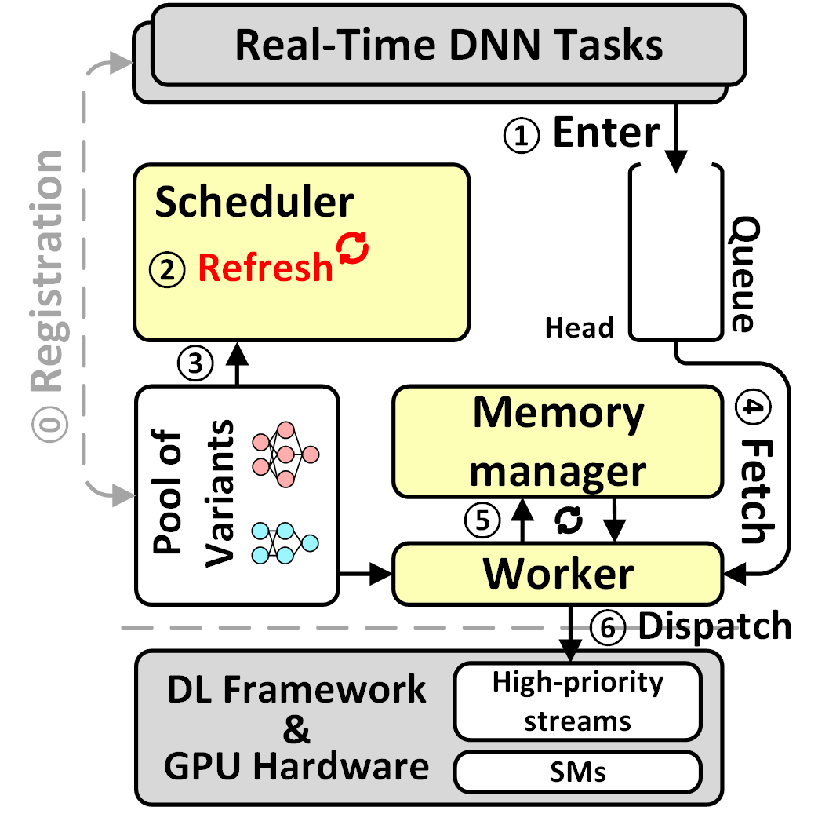



Design 1: Preemption Runtime
DNN Task
Chunks
DNN Slicing
Key Idea – Timely sort DNN chunks in the queue in order of priority
Design of memory manager, worker, queue, etc.
Preemptive scheduler

Slide 9
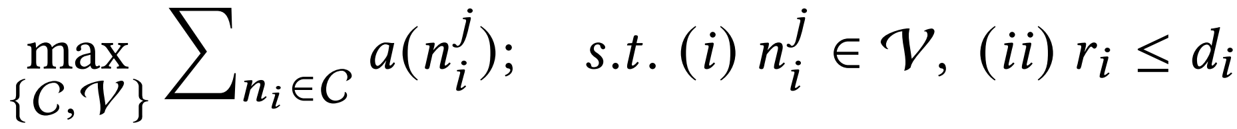
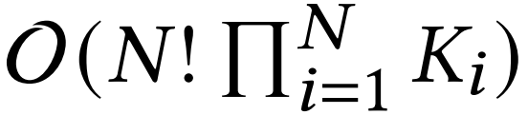
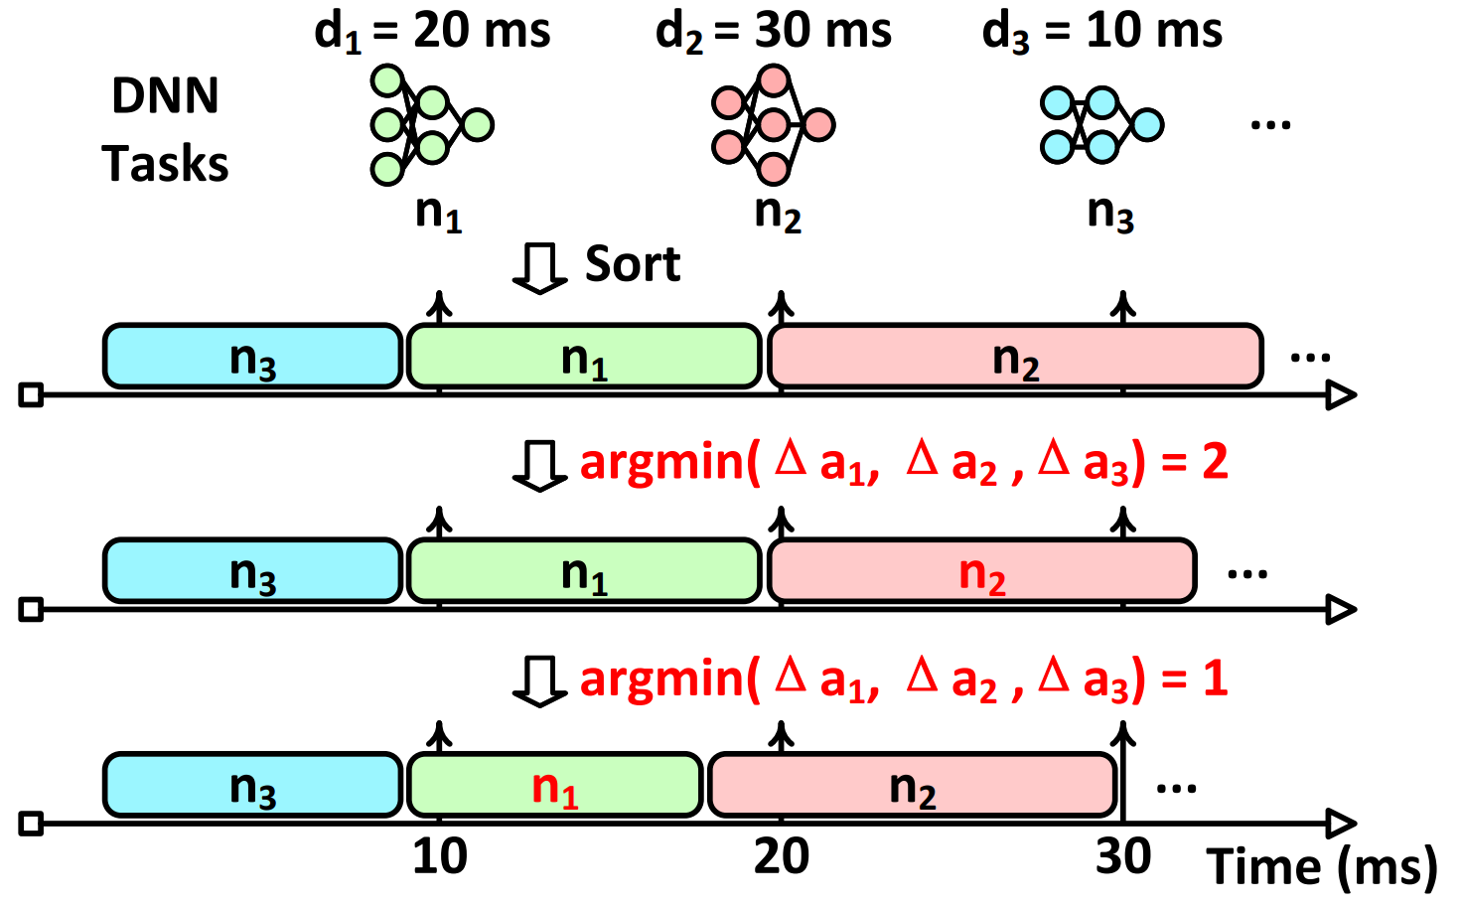
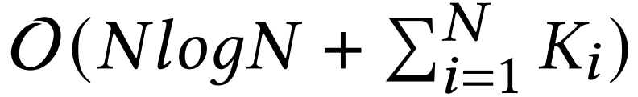
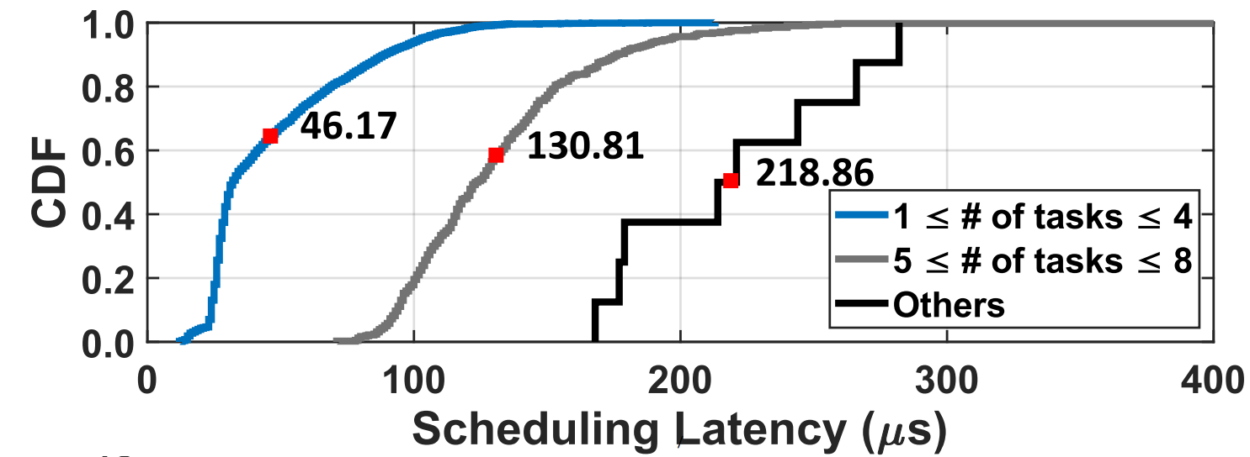
Design 1: Preemptive Scheduler
Earliest Deadline-First (EDF) can derive the optimal task execution order when 1) preemption is allowed, and 2) a feasible schedule exists^{[2]}
EDF
Variant
Selection
46–219 𝜇s
[2] Jane WS Liu et al. Real-time systems. Pearson Education India, 2006.

Slide 10
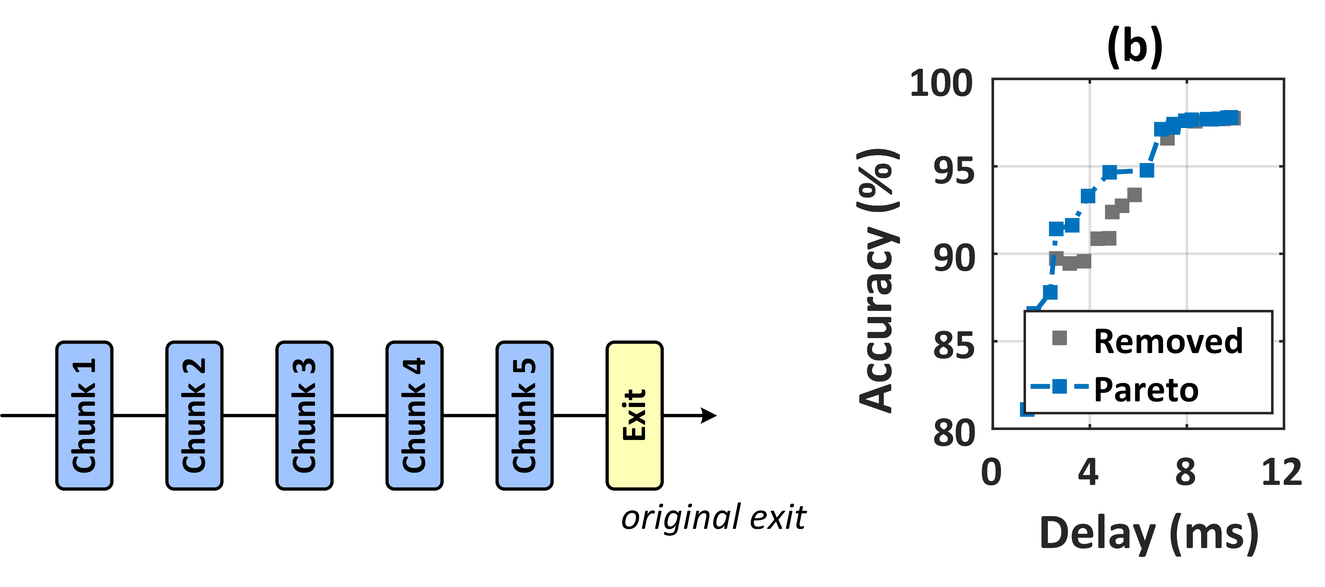
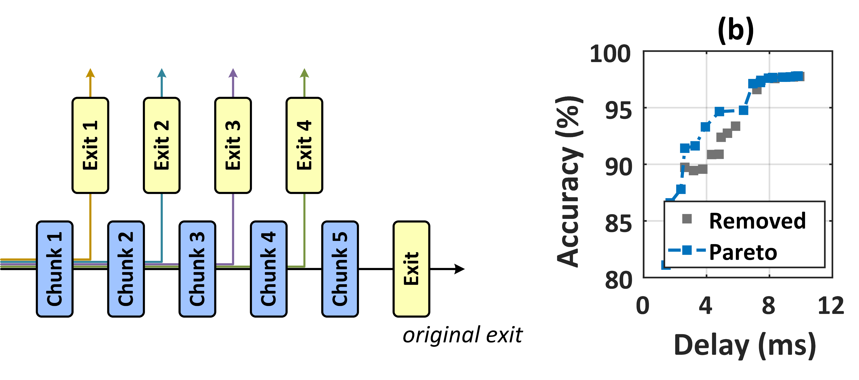
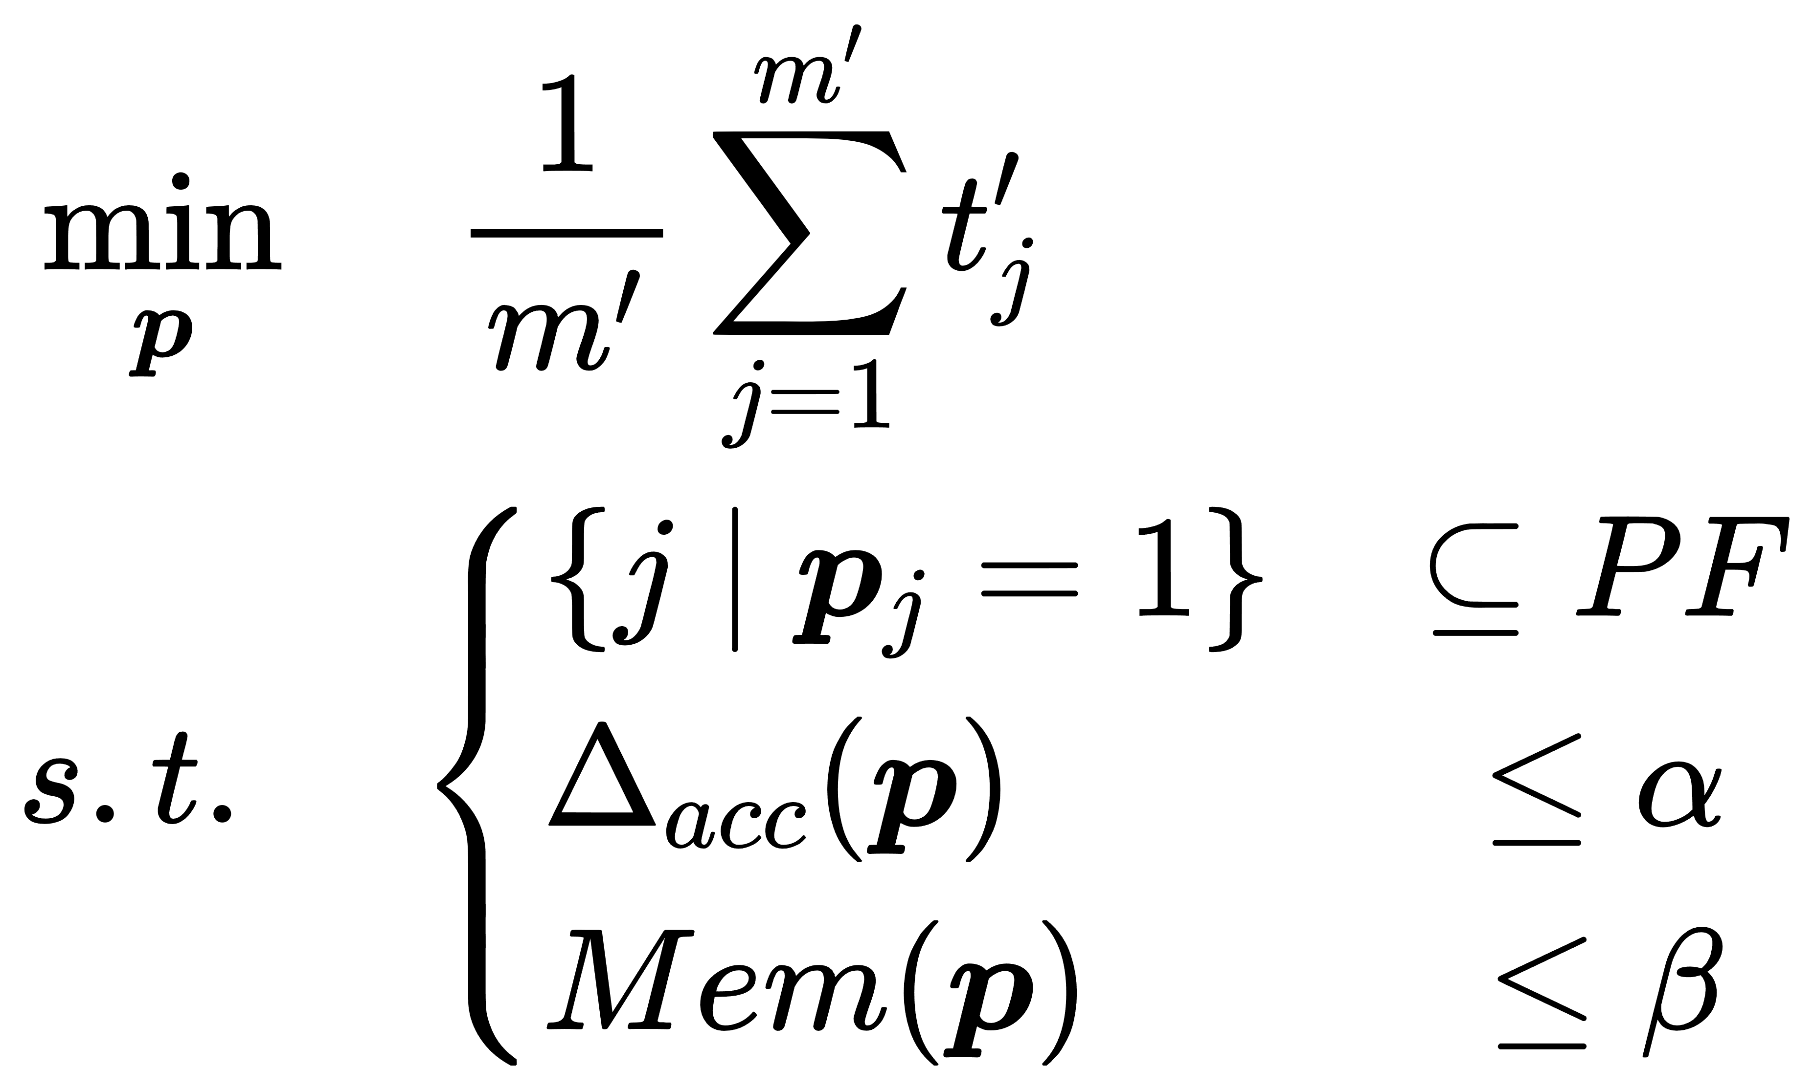
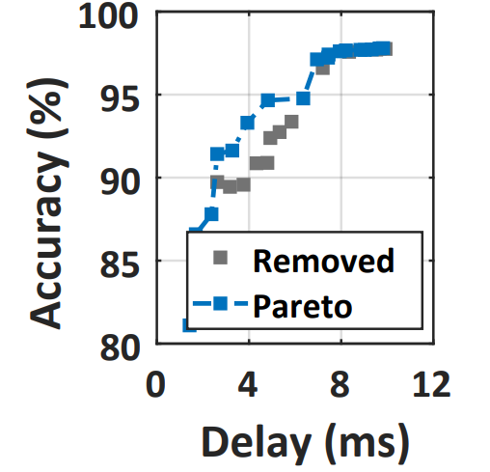
Design 2: Generation of DNN Variants
Early-exit mechanism for nested redundancy
Placement of early exits
Objective: minimize the delay from each chunk to its nearest exit
accuracy cons.
memory cons.

Slide 11
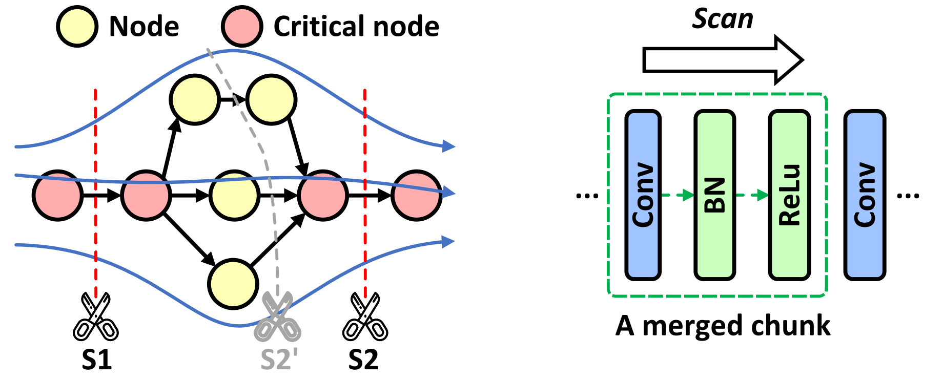
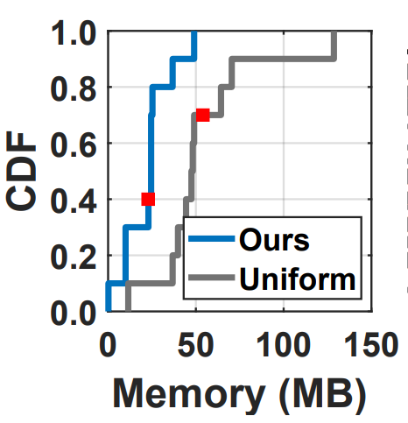
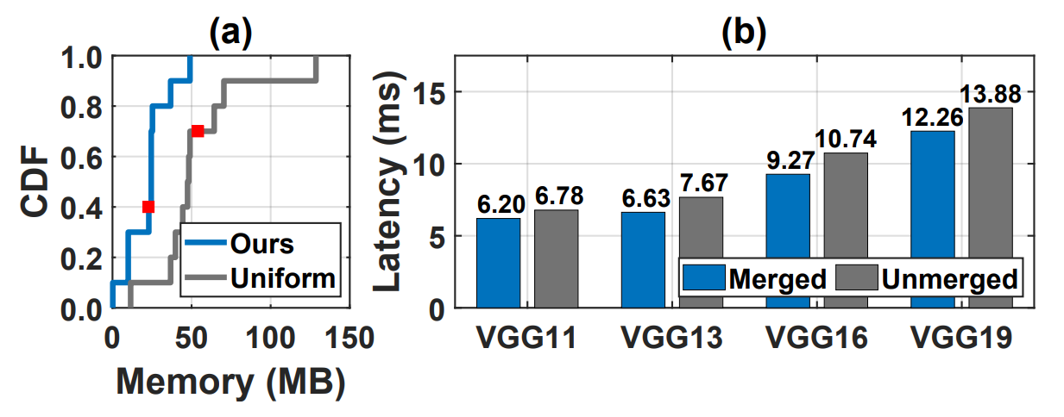
Design 2: DNN Slicing for Preemption
1) Design for slicing – minimize context-switching overhead
Context switching overhead
60.7% on average
2) Merge – enhance execution efficiency
lightweight layers
10.3% on average
Execution efficiency
computation-expensive layer

Slide 12
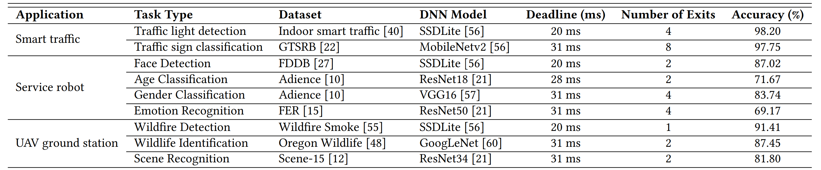
Pantheon Implementation
2 edge platforms
Nvidia Jetson Xavier NX
high-performance
Nvidia Jetson Nano
low-performance
3 applications
Smart traffic (4 tasks): 2×traffic light detection and 2×traffic sign classification
Service robot (4 tasks): face detection, age classification, gender classification and emotion recognition
UAV ground station (3 tasks): wildfire detection, animal identification and scene recognition
Test-bed

Slide 13
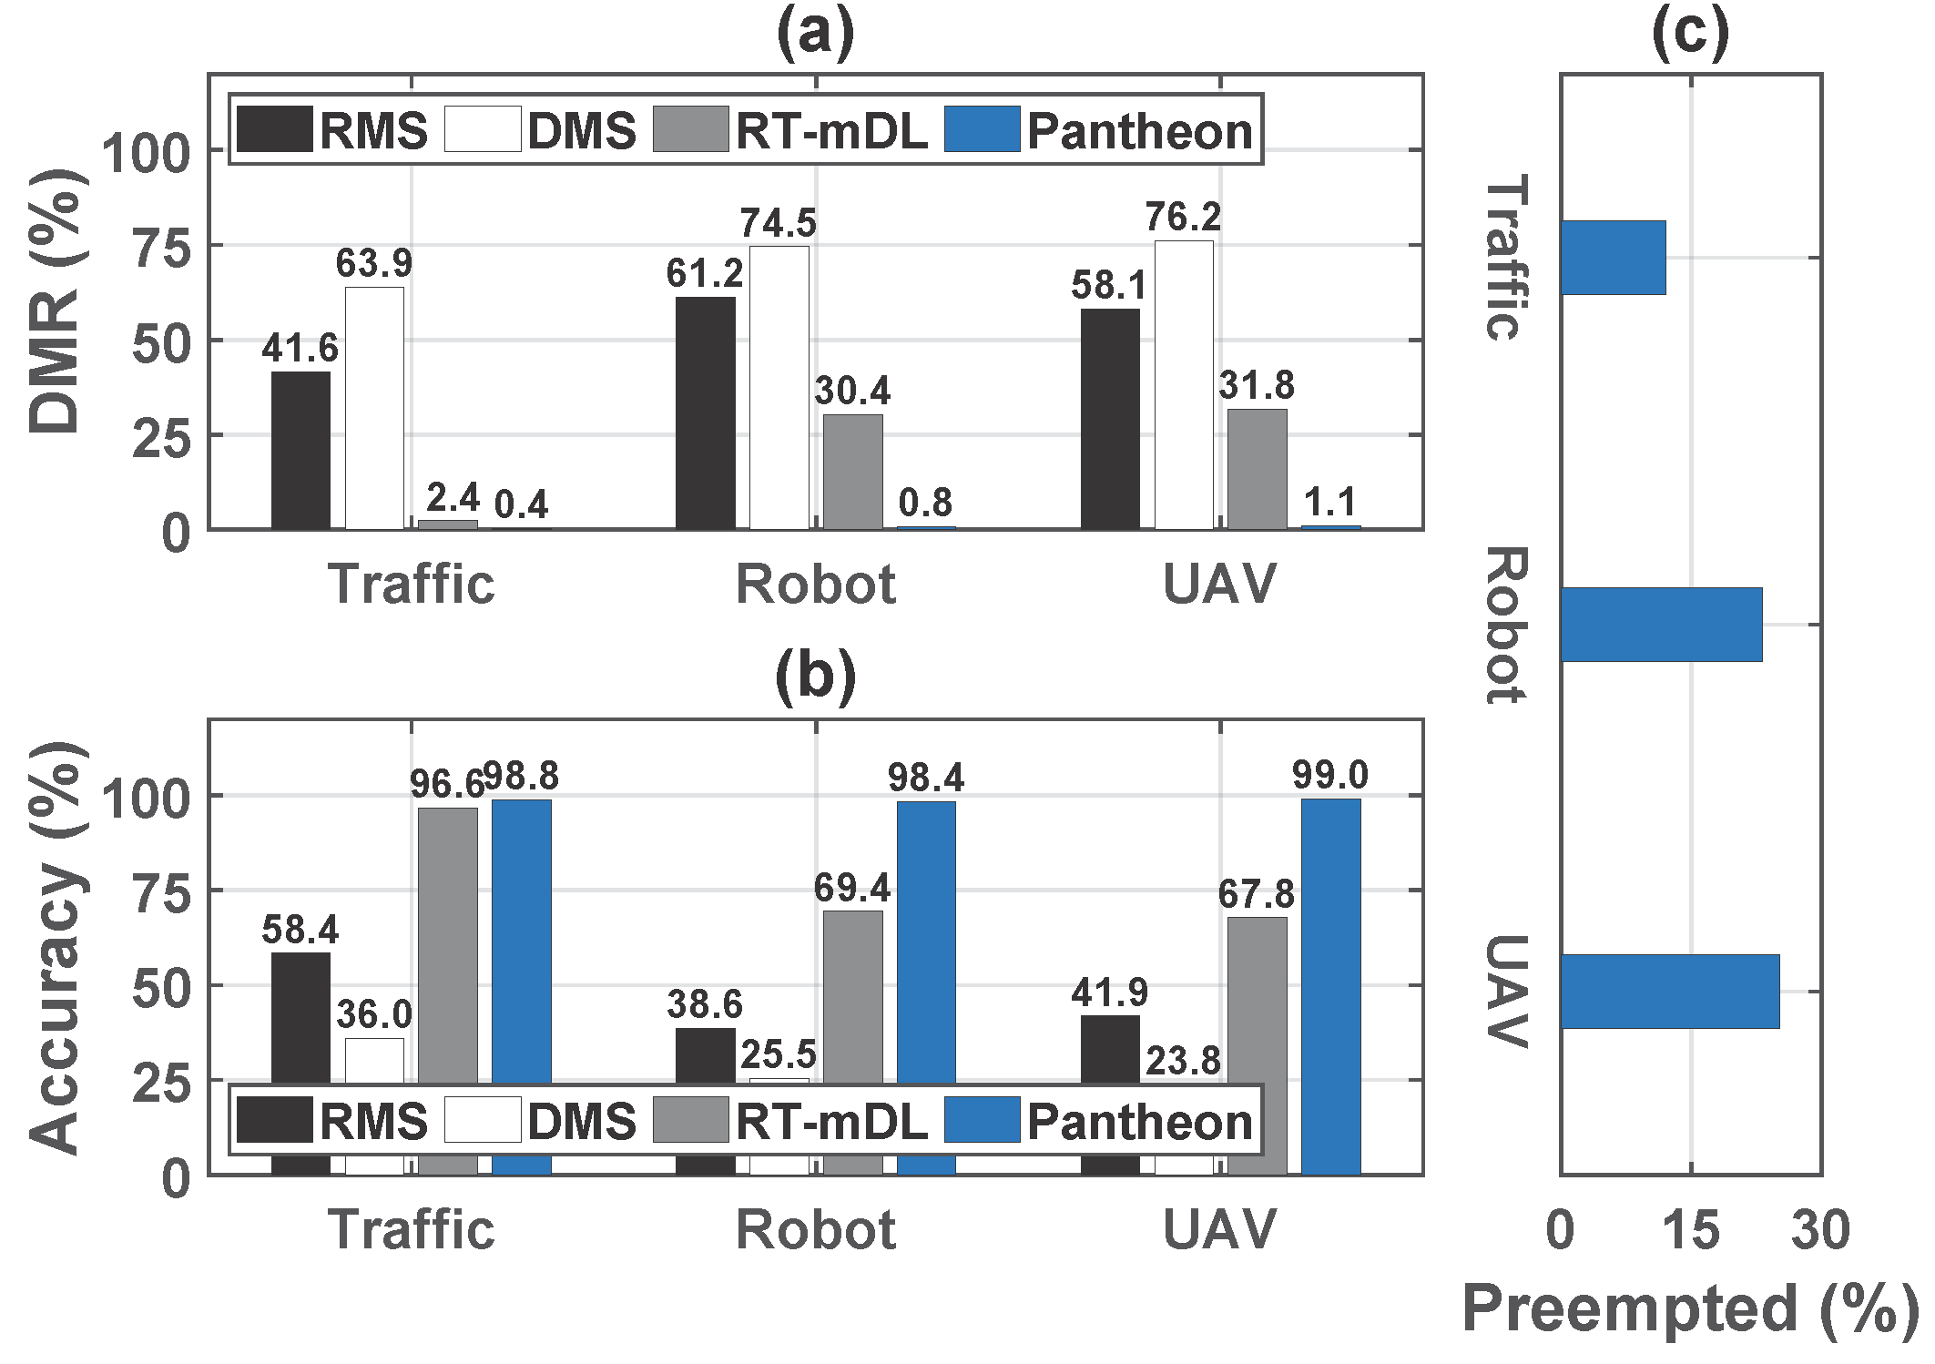
Overall Performance
Deadline miss rate
83.3–97.4% compared with SOTA
12–25% of jobs are preempted
[3] Ling, N., et al. RT-mDL: Supporting real-time mixed deep learning tasks on edge platforms. ACM SenSys 2021.

Slide 14
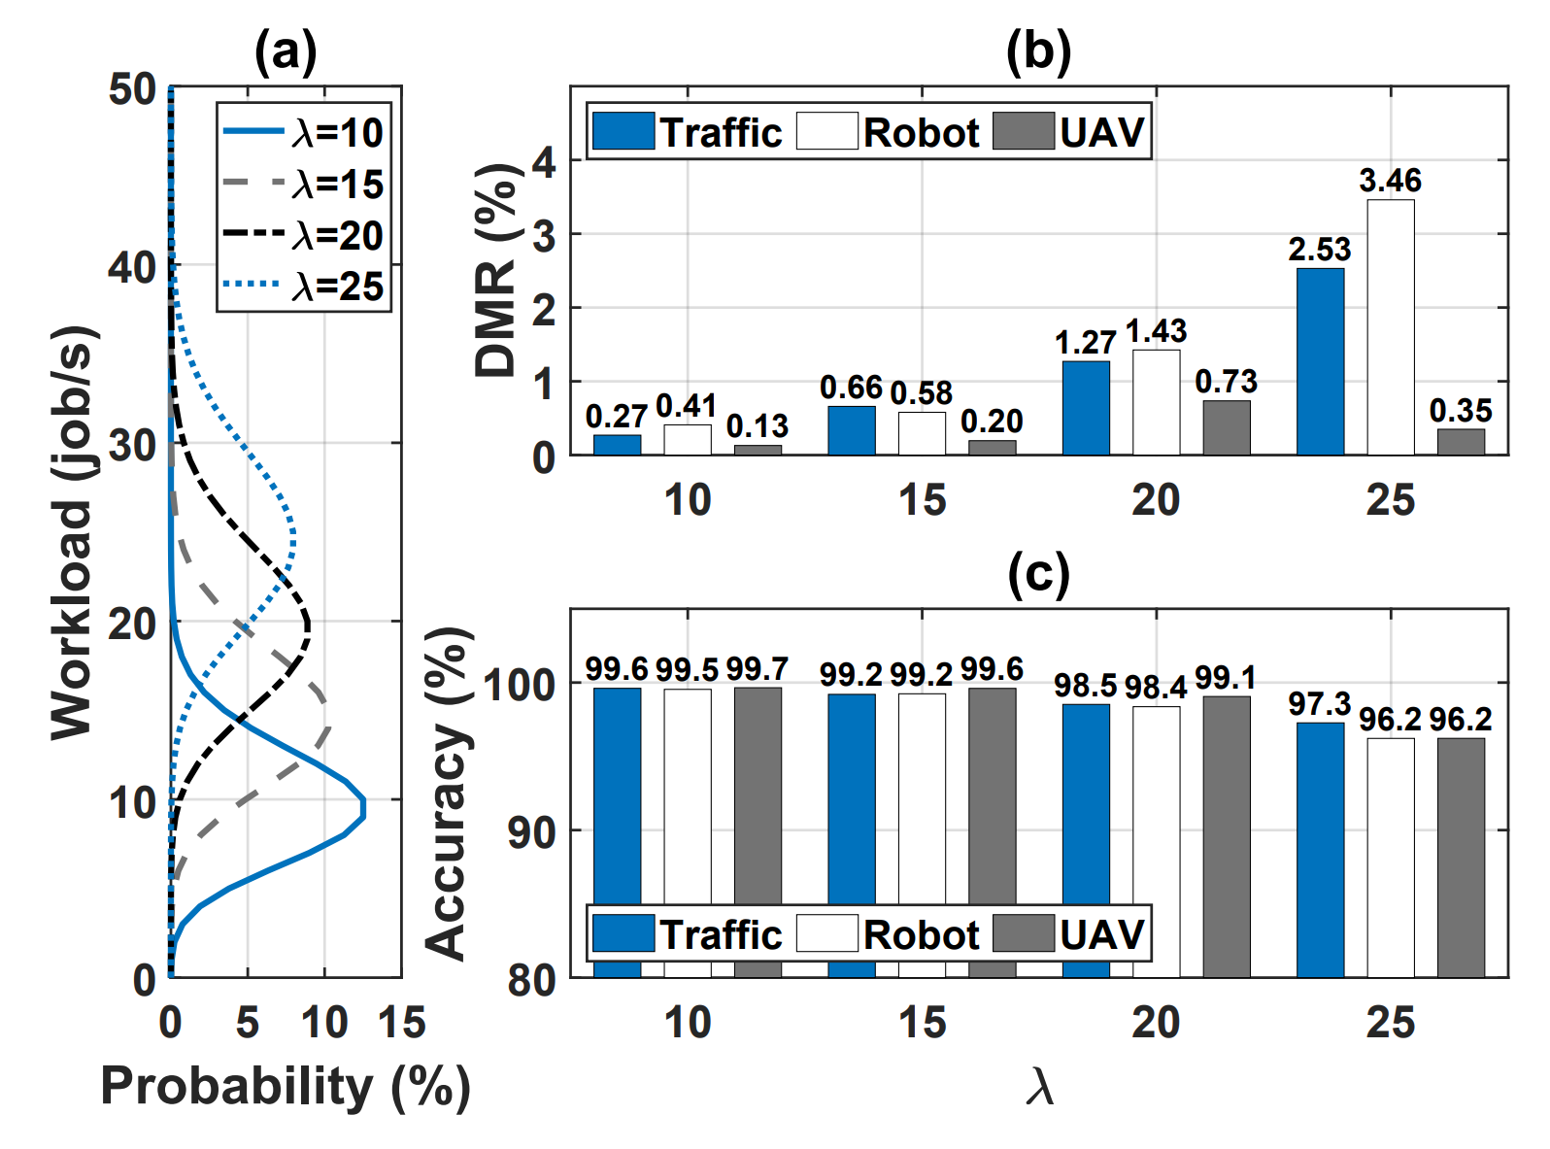
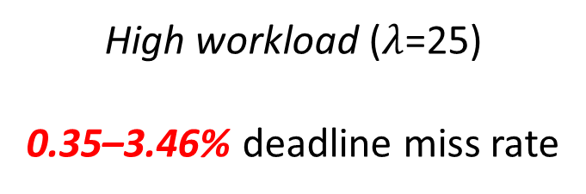
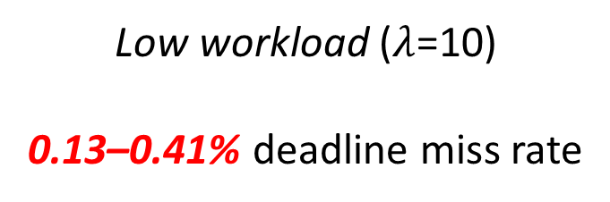
Non-periodic Task Arrivals
Vary the arrival rate of non-periodic tasks $λ$
Low workload ($λ$=10)
0.13–0.41% deadline miss rate
High workload ($λ$=25)
0.35–3.46% deadline miss rate

Slide 15
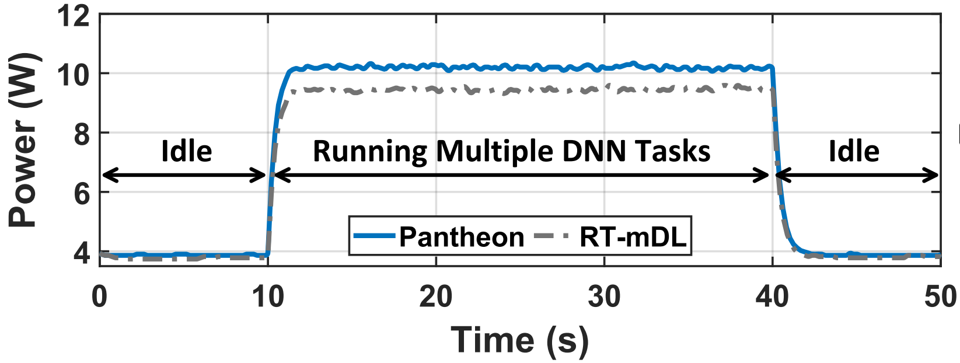
Power Consumption
10.15 W
4.3%
Power consumption 9.47 W

Slide 16
Conclusion
Propose Pantheon, a new preemption design for multi-DNN inference on mobile edge GPUs.
Includes an online runtime with comprehensive preemption logic and innovative scheduling, and offline DNN processing.
Develop a prototype system and conduct extensive evaluations showing significant performance gain.

Slide 17
Thank you! Q&A
Lixiang Han, Zimu Zhou, Zhenjiang Li
City University of Hong Kong
ACM MobiSys 2024

